Slide 1
Web Speech API
Arindam Ghosh

Slide 2
JavaScript API to integrate speech recognition into their web apps:
speech recognition for input
text-to-speech as output
Part of Web Speech API Specification of October 2012 Published by the Speech API Community Group.
Updated June 2014 version
https://dvcs.w3.org/hg/speech-api/raw-file/tip/webspeechapi.html

Slide 3
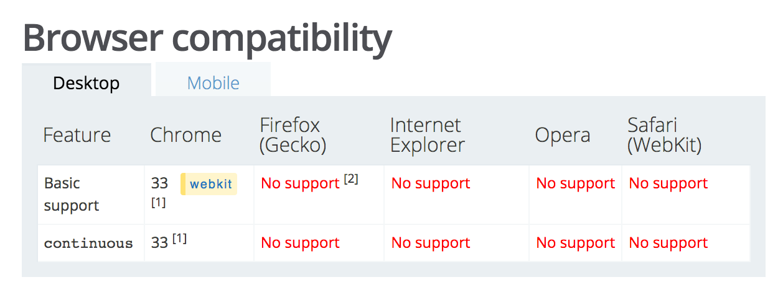
Prerequisites
Web Speech Supported Browser
Chrome > Version 33
Check by going to Chrome-> About Chrome
Apache web server with https support

Slide 4
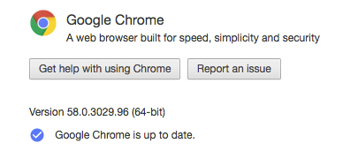
Chrome
Web Speech Supported Browser
Chrome > Version 33
Check by going to Chrome-> About Chrome

Slide 5
Initial setup
Install apache2
Linux: sudo apt-get install apache2
Mac: should be installed by default
Start apache
sudo apachectl start
Check its running
http://localhost/
http://127.0.0.1/

Slide 6
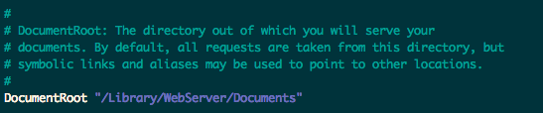

Initial setup.. contd
Check settings
/etc/apache2/httpd.conf
Check your DocumentRoot
Go to DocumentRoot
Create a document called Speech.html
Check it works

Slide 7


Changing DocumentRoot
Go to your apache2 root folder:
Edit httpd.conf - Change DocumentRoot
Restart Apache
sudo apachectl restart

Slide 8
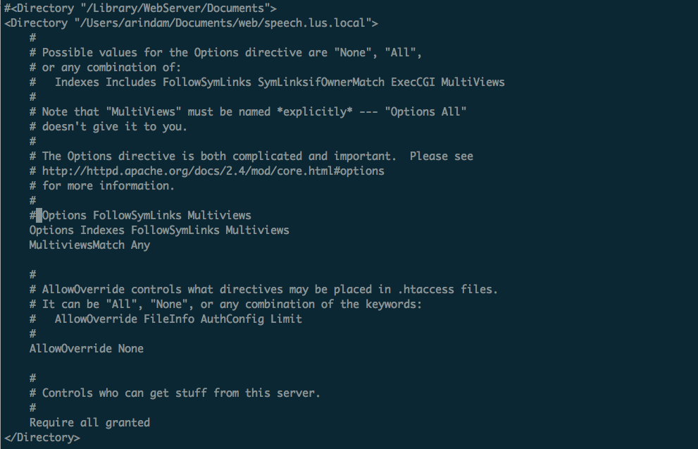
Update httpd.conf

Slide 9

Initial setup.. contd
Go to the new DocumentRoot
Create a document called Speech.html
Check it works

Slide 10
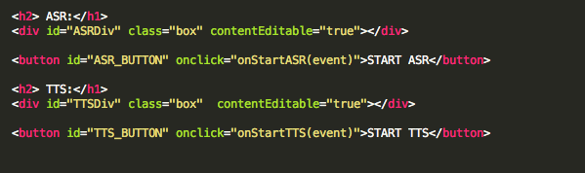

Edit speech.html
Add some style:
Check it works

Slide 11
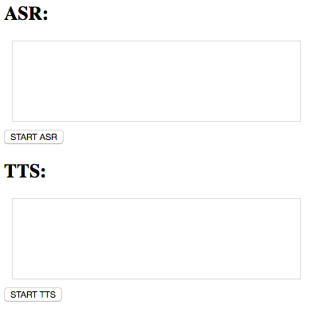
HTML Page

Slide 12
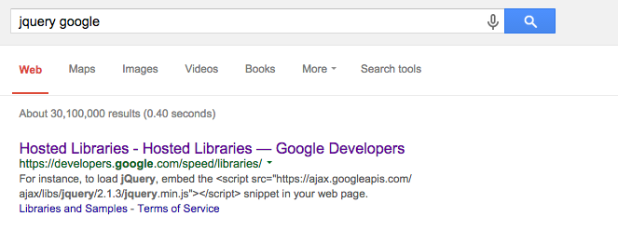
Add some JS magic
First some jquery

Slide 13
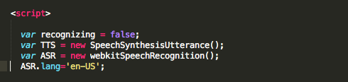
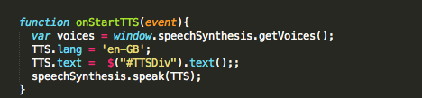
TTS

Slide 14

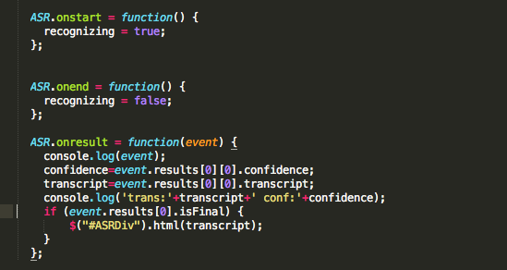
ASR

Slide 15
ASR and TTS
ASR
webkitSpeechRecognition()
TTS
SpeechSynthesisUtterance()
Currently supported by Google Chrome
Google ASR
TTS provided in Chrome

Slide 16
Speech Recognition
https://github.com/GoogleChrome/webplatform-samples/tree/master/webspeechdemo
var recognition = new webkitSpeechRecognition();
Check if your browser supports Speech Recognition:
if (!('webkitSpeechRecognition' in window)) {
alert('webkitSpeechRecognition not supported');
}else{
var recognition = new webkitSpeechRecognition();
...
...
}

Slide 17
Parameters
var ASR= new webkitSpeechRecognition();
ASR.lang = 'en-US';
ASR.continuous = true;
ASR.interimResults = true;
ASR.maxAlternatives=10;

Slide 18
Methods
Calls:
ASR.start();
ASR.stop();
Callbacks:
ASR.onstart = function() { ... }
ASR.onresult = function(event) { ... }
ASR.onend = function() { ... }
ASR.onerror = function(event) { ... }

Slide 19
On Recognition- Result
{
…
…
results: {
0: {
0: {
confidence: 0.695017397403717,
transcript: "this is a test of speech recognition on chrome"
},
isFinal:true,
length:1
},
length:1
},
…
…
}

Slide 20
LINK FOR CODE
http://bit.ly/LUS2017speech1

Slide 21

Check for errors

Slide 22

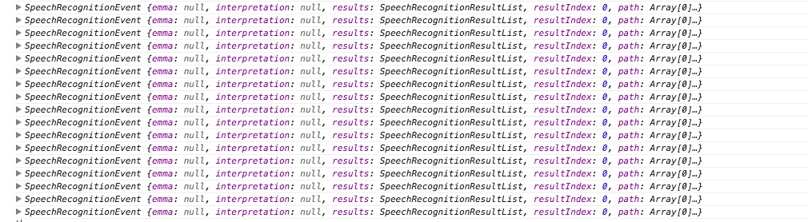
ASR Parameters
N-best : maxAlternatives
interimResults = true;

Slide 23
N-best
If maxAlternatives parameter is set.
SpeechRecognitionAlternative – returns maxAlternatives results.

Slide 24
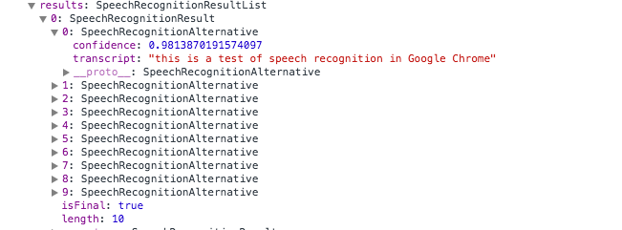
ASR onResult
events.results: An array containing the results of the recognition.
events.results[i]: ith recognized element.
events.results[i]. isFinal : A Boolean that indicates if the the result is final or interim.
events.results[i][j]: A 2D array containing alternative recognized words.
events.results[i][j].transcript: The text representation of the recognized word(s).
events.results[i][j].confidence: The probability of the result being correct.
The value ranges from 0 to 1.

Slide 25
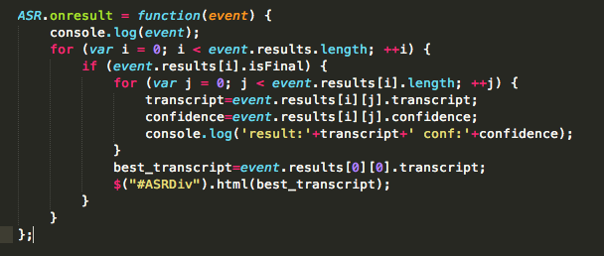
ASR onResult

Slide 26
Speech Synthesis
var utterance = new SpeechSynthesisUtterance();
window.speechSynthesis.speak(utterance);
var voices = window.speechSynthesis.getVoices();
TTS.lang = 'en-GB';
TTS.text = “I am your browser. I can speak”;
speechSynthesis.speak(TTS);

Slide 27

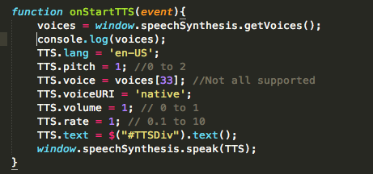
TTS Parameters
Voices need to initialized twice – known bug

Slide 28
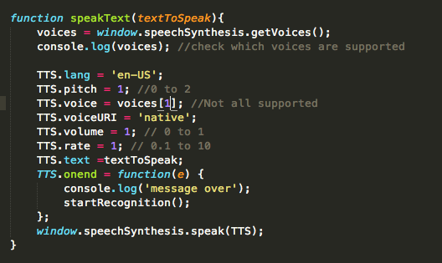
More….
Define a function called speakText similar to onStartTTS with textToSpeak
as input parameter

Slide 29
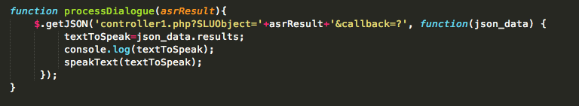
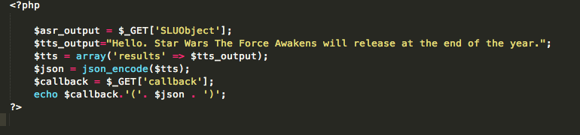
Lets get some results from server

Slide 30
A little bit of php

Slide 31
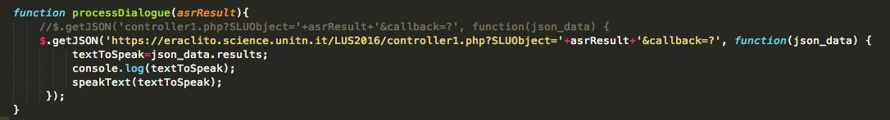
Use the Server

Slide 32
Download all the files
http://bit.ly/LUS2017Project

Slide 33
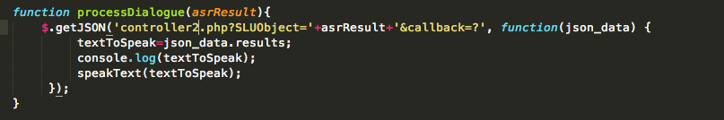
Movie time

Slide 34
Project
Look at the project folder.
Copy the whole folder to your apache directory.
Try it out.
Javascript is in LUS.js file

